Slide 1
Programming and Data Structures
Debasis Samanta
Computer Science & Engineering
Indian Institute of Technology Kharagpur
Spring-2017

Slide 2
Lecture #2
C-Programming Elements

Slide 3
Today’s discussion…
The basic structure of C programs.
Language elements in C.
Operators in C-language.
Variables in C-language.
Expressions in C-programs.
Automatic type conversion and type casting.

Slide 4
Basic structure of C Programs

Slide 5
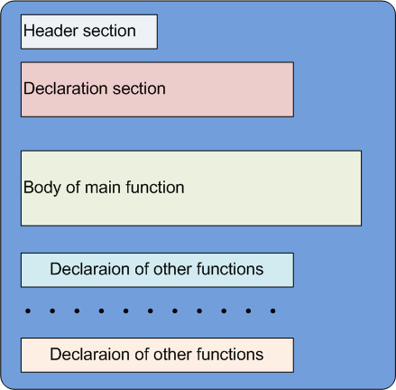
Basic Structure of C-Programs

Slide 6
Basic Structure of C Programs
Header section
C-language provides a number of library functions to support a programmer.
All these library functions are stored in files with extension .h. For example, all math related functions are stored in math.h library file
To include such a library, you have to specify it as
#include <libraryFile.h>
If you don’t include a priori, you may not get the functions defined in that library file and face compilation error.
<stdio.h> is a default library and in some compiler, need not to be included explicitly.
You can define your own library say “myLibrary.h” and include it as #include “myLibrary.h” (You should keep myLibrary.h in the same directory as your C-program is in; otherwise, specify the path explicitly.
This section is optional, that is, you may not necessarily include any library at all (except <stdio.h>)

Slide 7
Basic Structure of C-Programs
Declaration section
This section is also optional
In this section, you may define the following
Global variables
The variables, which is common to any functions in the program
Constant
You may need many constants in your program. Those constant can be defined in this section.
For example: #define PI 3.1428571 //Carefully note the syntax
Function prototype
Define only the name(s) of the function(s) and their arguments, if any, you wish to refer them later in any other functions(s) declaration.
For example: myFunction(int x; float y); //Carefully note the syntax

Slide 8
Basic Structure of C-Programs
Main function section
In each C-program, there should be one function called main().
All statements in this function should be enclosed within { …}
For example
void main() // In some compiler, “void” is optional
{
Statement 1
….
Statement i
}
main ( ) function may be with a zero or more list of argument(s).
The last statement of a main function should be a return statement.
For example
return 0; //Carefully note the syntax

Slide 9
Basic Structure of C-Programs
Other function declaration section
In a C-program, a programmer may define zero or more function(s)
All such function(s) should be defined/declared in this section in any order using the same syntax as the main ( ) function.
For example
[returnType] myFunction( [arg1; [arg2, ….]])
{
Statement 1
….
Statement i
}
The last statement in such a function should be a return statement and return a value compatible to [returnType].

Slide 10
An example
This program takes no input, but outputs the volume of a sphere.
You should save this program with an extension .c, for example geometry.c

Slide 11
Just for practice…
At this stage, it is a bit difficult for you but still you can have a try about it. What is the output, if input is “NOT”?

Slide 12
Just for practice…
Yes, the program looks correct but ultimately is failed to run! See the corrected version of the program.

Slide 13
Language Elements in C

Slide 14
The C-Character Set
The C language alphabet:
Uppercase letters ‘A’ to ‘Z’
Lowercase letters ‘a’ to ‘z’
Digits ‘0’ to ‘9’
C special characters:
White space character in C
\b blank space \t horizontal tab \v vertical tab \r carriage return \f form feed \n new line \\ Back slash \’ Single quote \" Double quote \? Question mark \0 Null \a Alarm (bell)

Slide 15
ASCII Codes of C-Character Set
C language recognizes total 256 ASCII codes; other 128 ASCII codes are for extended characters’ symbols

Slide 16
Keywords in C
Keywords
Keywords are those words whose meaning is already defined by Compiler; also called “reserved words” and cannot be used in identifier declaration
There are 32 keywords in C
C is a case-sensitive
programming
language!
Can you declare a function of your own having function name “strlen”?

Slide 17
Identifiers in C
Identifiers
Names given to various program elements (variables, constants, functions, etc.)
May consist of letters, digits and the underscore (‘_’) character, with no space between.
Blank and comma are not allowed.
First character must be an alphabet or underscore.
An identifier can be arbitrary long.
Identifier should not be a reserved word.
Some C compilers recognize only the first few characters of the name (16 or 31).
Case sensitive
‘area’, ‘AREA’ and ‘Area’ are all different.

Slide 18
Variables and Data Types in C

Slide 19
Variables
It is a data name that can be used to store a data value.
Example: x = 39, here x being a variable presently stored 39 in it
Unlike constants, a variable may take different values in memory during execution.
Variable names follow the naming convention for identifiers.
Examples: temp speed name2 current
int a, b, c; char x; a = 3; b = 50; c = a-b; x = ‘d’; b = 20; a = a+1; x = ‘G’;

Slide 20
Constants
Unlike a variable, a constant cannot store any value
Example: 325 = x; is absurd!
There are two types of constants

Slide 21
Integer Constants
Consists of a sequence of digits, with possibly a plus or a minus sign before it.
Example: 12345, +596, -137
Embedded spaces, commas and non-digit characters are not permitted between digits.
Maximum and minimum values (for 32-bit representations)
Maximum: 2147483647
Minimum: – 2147483648
What is the value of 10! Is it can be stored in a computer?

Slide 22
Floating-point Constants
Can contain fractional parts.
Very large or very small numbers can be represented.
Example: 23000000 can be represented as 2.3e7; here, e means “10 to the power of”
Two different notations:
Decimal notation
Example: 25.0, 0.0034, .84, -2.234
Exponential (scientific) notation
Example: 3.45e23, 0.123e-12, 123E2

Slide 23
Single Character Constants
Contains a single character enclosed within a pair of single quote marks (‘ ’).
Examples :: ‘2’, ‘+’, ‘Z’
Some special backslash characters
‘\n’ new line
‘\t’ horizontal tab
‘\’’ single quote
‘\”’ double quote
‘\\’ backslash
‘\0’ null

Slide 24
Single Character Constants
Sequence of characters enclosed in double quotes (“ “).
The characters may be letters, numbers, special characters and blank spaces.
Examples: “nice”, “Good Morning”, “3+6”, “3”, “C”
Differences from character constants:
‘C’ and “C” are not equivalent.
‘C’ has an equivalent integer value while, “C” does not.
int a, b, c; char x; a = 3; b = 50; c = a-b; x = ‘d’; b = 20; a = a+1; x = ‘G’;

Slide 25
Basic Data Types in C
int :: integer quantity
Typically occupies 4 bytes (32 bits) in memory.
char :: single character
Typically occupies 1 byte (8 bits) in memory.
float :: floating-point number (a number with a decimal point)
Typically occupies 4 bytes (32 bits) in memory.
double :: double-precision floating-point number
Precision refers to the number of significant digits after the decimal point.

Slide 26
Basic Data Types in C
Augmented data types in C
Some of the basic data types can be augmented by using certain data type qualifiers:
short
long
signed
unsigned
Typical examples:
short int
long int
unsigned int

Slide 27
Basic Data Types in C
Storage specification of different C data types
Type | Storage size (in byte) | Value range
char | 1 | -128 to 127 or 0 to 255
unsigned char | 1 | 0 to 255
signed char | 1 | -128 to 127
int | 2 or 4 | -32,768 to 32,767 or -2,147,483,648 to 2,147,483,647
unsigned int | 2 or 4 | 0 to 65,535 or 0 to 4,294,967,295
short | 2 | -32,768 to 32,767
unsigned short | 2 | 0 to 65,535
long | 4 | -2,147,483,648 to 2,147,483,647
unsigned long | 4 | 0 to 4,294,967,295
Character
Integer
Type | Storage size (in byte) | Value range | Precision
float | 4 | 1.2E-38 to 3.4E+38 | 6 decimal places
double | 8 | 2.3E-308 to 1.7E+308 | 15 decimal places
long double | 10 | 3.4E-4932 to 1.1E+4932 | 19 decimal places
Floating-point

Slide 28
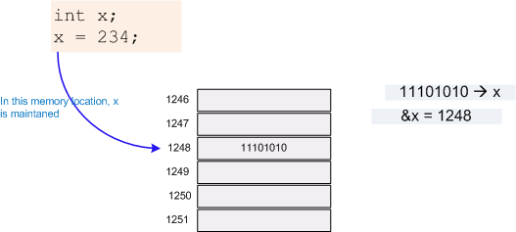
Declarations of Variables
There are two purposes:
1. It tells the compiler what the variable name is.
2. It specifies what type of data the variable will hold.
General syntax:
data-type variable-list;
Examples:
int velocity, distance;
int a, b, c, d;
float temp;
char flag, option;

Slide 29
Declarations of Variables
According to C-language, in an expression
A variable say x, refers to the contents of the memory location.
&x refers to the address of the memory location.
Examples:
scanf (“%f %f”, &x, &y);
printf (“%f %f %f”, x, y, x + y);

Slide 30
Declarations of Variables

Slide 31
Assignment in C-Language

Slide 32
Assignment in C
Used to assign values to variables, using the assignment operator (=).
General syntax:
variable_name = expression;
Examples:
velocity = 20;
b = 15; temp = 12.5;
A = A + 10;
v = u + f * t;
s = u * t + 0.5 * f * t * t;
Assignment during declaration
int speed = 30;
char flag = ‘y’;
Multiple variable assignment
a = b = c = 5;
flag1 = flag2 = ‘y’;
speed = flow = 20.0;

Slide 33
Assignment in C
In addition to = operator, C has a set of shorthand assignment operators of the form
var_name op= expression;
This is equivalent to
var_name = var_name op expression;
Examples
x += y+1; → x = x + (y+1);
x -= y → x = x-y;
a *= a; → a = a*a;
m %= n; → m = m%n;

Slide 34
Operators in C-Language

Slide 35
Operators in C
Operators
Arithmetic
Operators
Relational
Operators
Logical
Operators
Increment
Operators
Bit-wise
Operators

Slide 36
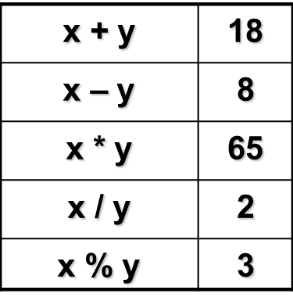
Arithmetic Operators
x = 13; y = 5;
Addition: +
Subtraction: -
Multiplication: *
Division: /
Modulus: %
Example:
distance = rate * time ;
netIncome = income - tax ;
speed = distance / time ;
area = PI * radius * radius;
y = a * x * x + b*x + c;
quotient = dividend / divisor;
remain = dividend % divisor;

Slide 37
Increment and Decrement Operators
C provides two unusual operators for incrementing and decrementing variables
Increment operator ++ : It adds 1 to its operand
Example: ++x; (prefix operator)
x++; (postfix operator)
These are equivalent to x = x + 1;
y = ++x; is equivalent to y = x + 1;
Note: y = ++x; and y = x++; are different.
++x increments x before its value is used, while
x++ increments x after its value has been used.
x = 5; | x | y
y = ++x; | 6 | 6
y = x++; | 6 | 5

Slide 38
Increment and Decrement Operators
Decrement operator -- : It subtracts 1 from its operan
Example: --x; (prefix operator)
x--; (postfix operator)
These are equivalent to x = x - 1;
Note: y = x--; is not same as y = --x;
Note: increment (++) and decrement (--) operators are only applicable
to variables (integer).
Examples:
(i + j)++; is illegal! This is because (i+j) is not an integer variable name
Suppose, a = 10, b = 5; Following two in sequence, if executed
c = ++a – b will result c = 6;
c = b-- + a will result c = 16;

Slide 39
Bitwise Operators
C provides six operators for bit manipulation
These operators may be applied to only integral operands, that is, char, short, int, and long (both signed and unsigned)
x = 5 (0101), y = 12 (1100)
Operator | Meaning | Usage | Example
& | Bitwise AND | z = x & y | z = 0100 (4)
| | Bitwise OR | z = x | y | z = 1101 (13)
^ | Bitwise exclusive OR | z = x ^ y | z = 1001 (9)
<< | Left shift | z = x << u | z = 0100 (4)
>> | Right shift | z = x >> u | z = 0001(1)
~ | One’s complement | z = ~x | z = 1010 (10)
u is an unsigned integer
See illustrations for left-shift and right-shift operations in the next slide

Slide 40
Bitwise Operators
Assume x = 0x5cb6 (the operand, i.e. bit pattern in hexa-decimal notation) and u = 6 (an unsigned number, i.e., number of displacements required)
Left-shift operation
Right-shift operation

Slide 41
Relational Operators
Used to compare two quantities.
< is less than
> is greater than
<= is less than or equal to
>= is greater than or equal to
== is equal to
!= is not equal to

Slide 42
Relational Operators
Examples:
10 > 20 is false
25 < 35.5 is true
12 > (7 + 5) is false
12 >= (7 + 5) is true
When arithmetic expressions are used on either side of a relational operator, the arithmetic expressions will be evaluated first and then the results compared.
Example:
a + b > c – d is the same as (a+b) > (c-d)

Slide 43
Relational Operators
Example:
Sample code segment in C
if (x > y)
printf (“%d is larger\n”, x);
else
printf (“%d is larger\n”, y);

Slide 44
Logical Operators
There are two logical operators in C (also called logical connectives).
&& ------- Logical AND
| | ------- Logical OR
What they do?
They act upon operands that are themselves logical expressions.
The individual logical expressions get combined into more complex conditions that are true or false.
Example
(a > b) && (c < d) || ((a-b) != (c-d))
results TRUE if a = 5, b = 2, c = 1 and d = 4

Slide 45
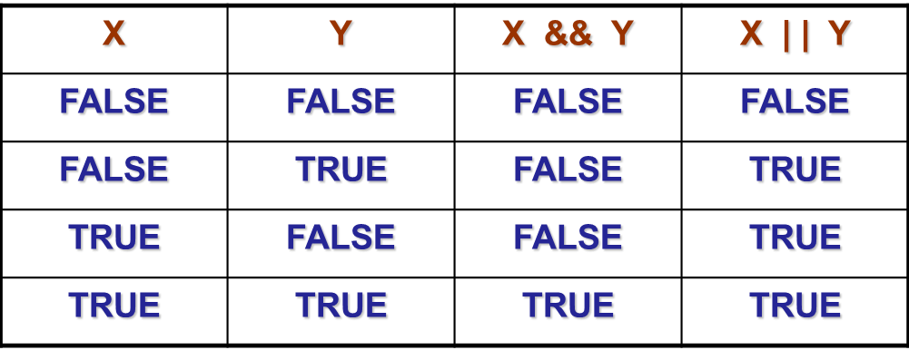
Logical Operators
Logical AND
Result is true if both the operands are true.
Logical OR
Result is true if at least one of the operands are true.

Slide 46
Operator Precedence and Associativity
Operator | Associativity | Precedence
( ) | Left to Right | 1
(unary) | Right to Left | 2
--, ++
!, ~
*, /, % | Left to Right | 3
+, - | Left to Right | 4
<<, >> | Left to Right | 5
<, <=, >, >= | Left to Right | 6
== , != | Left to Right | 7
& | Left to Right | 8
^ | Left to Right | 9
| | Left to Right | 10
&& | Left to Right | 11
|| | Left to Right | 12
?: | Right to Left | 13
Assignment operators
namely =, +=, -=, *=
and %= are of
lowest priority and
right to left associativity

Slide 47
Operator Precedence and Associativity
Assignment operators namely =, +=, -=, *= and %= are of lowest priority and right to left associativity
For operators of the same priority, evaluation is from left to right as they appear.
Parenthesis may be used to change the precedence of operator evaluation.
Examples:
v = u + f * t; → v = u+(f*t);
X = x * y / z → X = (x*y)/z
A = a + b – c * d / e → A = ((a+b)-((c*d)/e))
A = -b * c + d % e → A = (((-b)*c)+(d%e))

Slide 48
Operator Precedence
Parenthesis may be used to change the precedence of operator evaluation.
Example:
a + b * c – d / e → a + (b * c) – (d / e)
a * – b + d % e – f → a * (– b) + (d % e) – f
a – b + c + d → (((a – b) + c) + d)
x * y * z → ((x * y) * z)
a + b + c * d * e → (a + b) + ((c * d) * e)

Slide 49
Integer arithmetic
When the operands in an arithmetic expression are integers, the expression is called integer expression, and the operation is called integer arithmetic.
Integer arithmetic always yields integer values.
Operators applicable
All arithmetic operators
All logical operators
All relational operators
All increment and decrement operators
All bit-wise operators

Slide 50
Real Arithmetic
Arithmetic operations involving only real or floating-point operands.
Since floating-point values are rounded to the number of significant digits permissible, the final value is an approximation of the final result.
Examples
1.0 / 3.0 * 3.0 will have the value 0.99999 and not 1.0
a = 22/7*7*7 = (((22/7)*7)*7) = 153.86
b = 22*7/7*7 = (((22*7)/7)*7) = 154
The modulus operator cannot be used with real operands.

Slide 51
Mixed-mode Arithmetic
When one of the operands is integer and the other is real, the expression is called a mixed-mode arithmetic expression.
If either operand is of the real type, then only real arithmetic is performed, and the result is a real number.
25 / 10 → 2
25 / 10.0 → 2.5
Some more issues will be considered later.

Slide 52
Automatic Type Conversion
C language permits mixing of constants and variables of different types in an expression
During evaluation it adheres to very strict rules of type conversion
If operands are of different types, the lower type is automatically converted to the higher type before the operation proceeds
LOWER int < long < float < double HIGHER
char and short are automatically converted to int.
If one operand is unsigned, then other is converted to unsigned and the result is in unsigned
float is automatically converted to double
If one operand is double, then other is converted to double and the result is in double
If one operand is long, then the other operand is converted to long

Slide 53
Automatic Type Conversion
int a = 10, b = 4, c;
float x, y;
double z;
c = a / b;
x = a / b;
y = a / 3.0
z = 2 / 1.0;
The value of c will be 2
The value of x will be 2.0
The value of y will be 3.333333333
The value of z will be 2.00000000000000 (and in double precision)
float to int causes truncation of the fractional part
double to float causes rounding of digits
long int to int causes dropping of the excess higher order bits

Slide 54
Automatic Type Conversion

Slide 55
Type Casting
C language allows to force a type conversion, which is different than the automatic type conversion
The syntax for such a type casting is
(type_name) expression;
Example
int a = 4, b = 5; float x; double y;
x = (float) a / b; // division is done in floating point mode, x = 0.8
a = (int) x / b; // Result is converted to integer by truncation, a = 0
y = (char) b / a; // It may report wrong type conversion

Slide 56
Type Casting
A faulty reciprocal finder
#include <stdio.h>
int main ()
{
int n;
scanf("%d",&n);
printf("%f\n",1/n);
return 0;
}

Slide 57
Type Casting
A faulty reciprocal finder
#include <stdio.h>
int main ()
{
int n;
scanf("%d",&n);
printf("%f\n",1/n);
return 0;
}
The division 1/n is of integers (quotient).
The format %f is for printing the value.

Slide 58
Type Casting
Two solutions
Solution 1: Solution 2
#include <stdio.h> #include <stdio.h>
int main () int main ()
{ {
int n; int n; float x;
scanf("%d",&n); scanf("%d",&n);
printf("%f\n",1.0/n); x = (float)1/n;
return 0; printf("%f\n",x);
} return 0;
}

Slide 59
Any question?
You may post your question(s) at the “Discussion Forum” maintained in the course Web page.

Slide 60
Problems to ponder…
Why the term “C” in C-programming language?
Why a C-program is required to be compiled before it is to be executed?
How a C-program is converted into an executable program?
If you write a C-program, with out any main(), what will be the result? What will happen, if you define a function (including mail () ) without return statement in it?
Can you define another function say f2() within a function f1()? If so, how?
What is the concept of “recursive function”?
What is called “command line arguments” in main ( )?
What is a “syntax error” and a “semantic error”? Give examples for each.
Which of the following is valid and invalid so far they are identifier are concerned
num 1 num_1 _num1 1_num int continue Char %rate

Slide 61
Problems to ponder…
Why “header section” in C programs also called “preprocessor”?
If you declare an identifier in “global declaration section” as well as declared the same in the main function, what will happen?
Suppose, you declare a variable in main(), and then refer it inside another function where it is not defined. If the function is called from the main(), whether it will work?
Suppose, you declare a variable in global section. If you print the value of variable prior any initialization or assignment operation, what value it will print?
Whether is the any precedence relationship in “relational operators”. If so, how it is?
Arithmetic expression is usually expressed in “infix” notation. Other than, the infix notation, there are two more: “prefix” and “postfix” notations. What are these?
If x = 13.0 and y = 5.0 and z = x % y. What will be the value of z in this case?

Slide 62
Problems to ponder…
If x = 5, then what will be the values of y in a) y = ++x; and b) y = x++;
What will be the value of x in x = x & 0177;
Given x as an integer variable, how you can transfer its value so that its binary representation will look like 01010101010101 (i.e., 1 followed by each zeros.) Hint: Use bitwise operators.
What is the largest value of n so that the value of n! can be stored in x declared as int?
Suppose a = 0x6db7 (in hexadecimal notation). What will be the value (in hexadecimal) of b if b = a & ~0xfc00?
Suppose a = 0x6db7 (in hexadecimal notation). What will be the value (in hexadecimal) of b if b = a << 5 and a >> 4?
Suppose, x = 2; What value the following statement will print?
printf(“x1 = %d, x2 = %d, x3 = %d”, x, ++x, x++);
printf(“x1 = %d, x2 = %d, x3 = %d”, x, x--, --x);

Slide 63
Problems to ponder…
What is the simplified and equivalent code of the statement a[i++] = 10;
Resolve the precedence and associativity in the expression m = n++ -j + 10; and evaluate if n = 1, j = 2.
What will be the equivalent code of m %= n += p;
What the following code will print
int x; x = 48; printf(“x = %c\n”,x);
What the following code will print
char a; a = ‘0’; printf(“a = %d\n”,a);
If char c; int i = 1, float f = 2.0, double d = 2.5, then what value the following expression will result?
c = i / f / f * d;

Slide 64
Problems for practice…
You can check the Moodle course management system for a set of problems for your own practice.
Login to the Moodle system at cse.iitkgp.ac.in
Select “PDS Spring-2017 (Theory) in the link “My Courses”
Go to Topic 2: Practice Sheet #02 : C Programming Elements
Solutions to the problems in Practice Sheet #02 will be uploaded in due time.

Slide 65
If you try to solve problems yourself, then you will learn many things automatically.
Spend few minutes and then enjoy the study.

